Slide 1
NORMALIZATION OF DATABASE
BY
SAKTHIVEL.A

Slide 2
NORMALIZATION
In database, Normalization is used to remove the duplicate data and database anomalies from relational table.
It also helps us to reduce data redundancy.
TYPES OF ANOMALIES:
Insertion anomalies
Deletion anomalies
Updation anomalies

Slide 3
EXAMPLE FOR ANOMALIES
Std_id | Std_Name | Dept | HOD | Office_No
1 | AAA | CSE | Mr.JD | 1234
2 | BBB | CSE | Mr.JD | 1234
3 | CCC | CSE | Mr.JD | 1234
When we insert a new row to this table, we need to insert repeated values for it which an insertion anomaly.
When we delete the student details from this table the department details will also get deleted along with the student details which is a deletion anomaly.
If we want to change the HOD name then we have to change it in all the rows which is an updation anomaly.

Slide 4
FIRST NORMAL FORM
A table is in First Normal form if it satisfies the following conditions:
Each column should contain atomic values.
A column should contain values in same data type.
Each column should have a unique name.
Order doesn’t matter.

Slide 5
EXAMPLE
Roll_No | Name | Course
101 | AAA | C,C++
102 | BBB | Java
103 | CCC | Python,Java
TABLE IN 1NF
Roll_No | Name | Course
101 | AAA | C
101 | AAA | C++
102 | BBB | Java
103 | CCC | Python
103 | CCC | Java

Slide 6
SECOND NORMAL FORM
Table should be in 1NF
No partial dependency should be there in the table.
PARTIAL DEPENDENCY:
Partial dependency is means, a non primary attribute depends on a part of a primary key (candidate key).

Slide 7
EXAMPLE
Std_id | Subject_id | Marks | Teacher
101 | 11 | 82 | Mr.A
101 | 12 | 85 | Mr.B
102 | 11 | 90 | Mr.A
In the above table, (Std_id + Subject_id) are primary keys and teacher column partially depends only on Subject_id column.
TABLE IN 2NF
Std_id | Subject_id | Marks
101 | 11 | 82
101 | 12 | 85
102 | 11 | 90
Subject_id | Teacher
11 | Mr.A
12 | Mr.B

Slide 8
THIRD NORMAL FORM
Table should be in 2NF.
No Transitive dependency is allowed.
TRANSITIVE DEPENDENCY
A non primary attribute depends on another non primary attribute is called Transitive dependency.

Slide 9
EXAMPLE
Std_id | Subject_id | marks | Exam_Name | Total_Marks
101 | 10 | 52 | Theory | 60
102 | 11 | 17 | Practicals | 20
103 | 12 | 18 | Assignments | 20
In the above table, Total_Mart column which is a non-primary attribute depends on another non-primary attribute which is Exam_Name.
TABLE IN 3NF
Std_id | Subject_id | marks | Exam_Name
101 | 10 | 52 | Theory
102 | 11 | 17 | Practicals
103 | 12 | 18 | Assignmants
Exam_Name | Total_Marks
Theory | 60
Practicals | 20
Assignmants | 20

Slide 10
BOYCE CODD NORMAL FORM
Table should be in 3NF.
For any dependency A -> B, A should be a super key.
NOT ALLOWDED
No primary attribute depends on a non-primary attribute

Slide 11
EXAMPLE
Std_id | Subject | Professor
101 | Java | P.Java1
101 | C++ | P.CPP
102 | Java | P.Java2
In the above table, the primary attribute Subject depends on a non-primary attribute Professor.
TABLE IN BCNF
Std_id | P_id
101 | 1
101 | 2
102 | 3
P_id | Professor | Subject
1 | P.Java1 | Java
2 | P.CPP | C++
3 | P.Java2 | Java

Slide 12
FOURTH NORMAL FORM
Table should be in BCNF.
It should not have multi-valued dependency.
CONDITIONS OF MULTI-VALUED DEPENDENCY
A -> B, For a single value of A, more than one value of B exist.
Table should have atleast 3 columns.
For a table with A, B, C columns, B and C should be independent.

Slide 13
EXAMPLE
Std_id | Course | Hobby
101 | Science | Cricket
101 | Maths | Hockey
102 | C++ | Crickey
102 | PHP | Hockey
In the above table, Std_id have more than one value in the other two columns and the other two columns (Course and Hobby ) are having no relationship.
TABLE IN 4NF
Std_id | Course
101 | Science
101 | Maths
102 | C++
102 | PHP
Std_id | Hobby
101 | Cricket
101 | Hockey
102 | Crickey
102 | Hockey

Slide 14
FIFTH NORMAL FORM
Table should be in 4NF.
It should not have join dependency.
JOIN DEPENDENCY
If we break a table into two tables and again if we try to join that tables, if the joined table have a problems like
Additional informathon creation or
Information loss
Then the table is having join dependency.

Slide 15
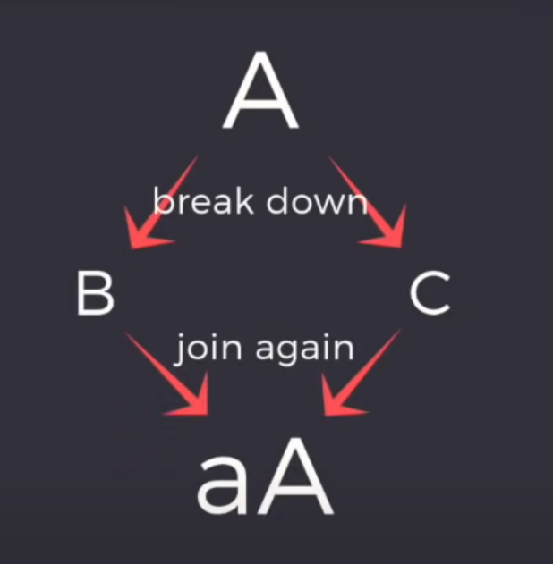
EXAMPLE
JOIN DEPENDENCY
Supplier | Product | Customer
S1 | P1 | C1
S1 | P2 | C2
S2 | P3 | C3
S2 | P4 | C4
S3 | P1 | C1

Slide 16
SPLITTING THE TABLE
Supplier | Product
S1 | P1
S1 | P2
S2 | P3
S2 | P4
S3 | P1
Customer | Product
C1 | P1
C2 | P2
C3 | P3
C4 | P4
Supplier | Customer
S1 | C1
S1 | C2
S2 | C3
S2 | C4
S3 | C1
PROBLEM
After splitting the table, if we try to get to know about an information “ S1 sells P1 to C1 “ it is losted.

Slide 17
THANK YOU

